Slide 1
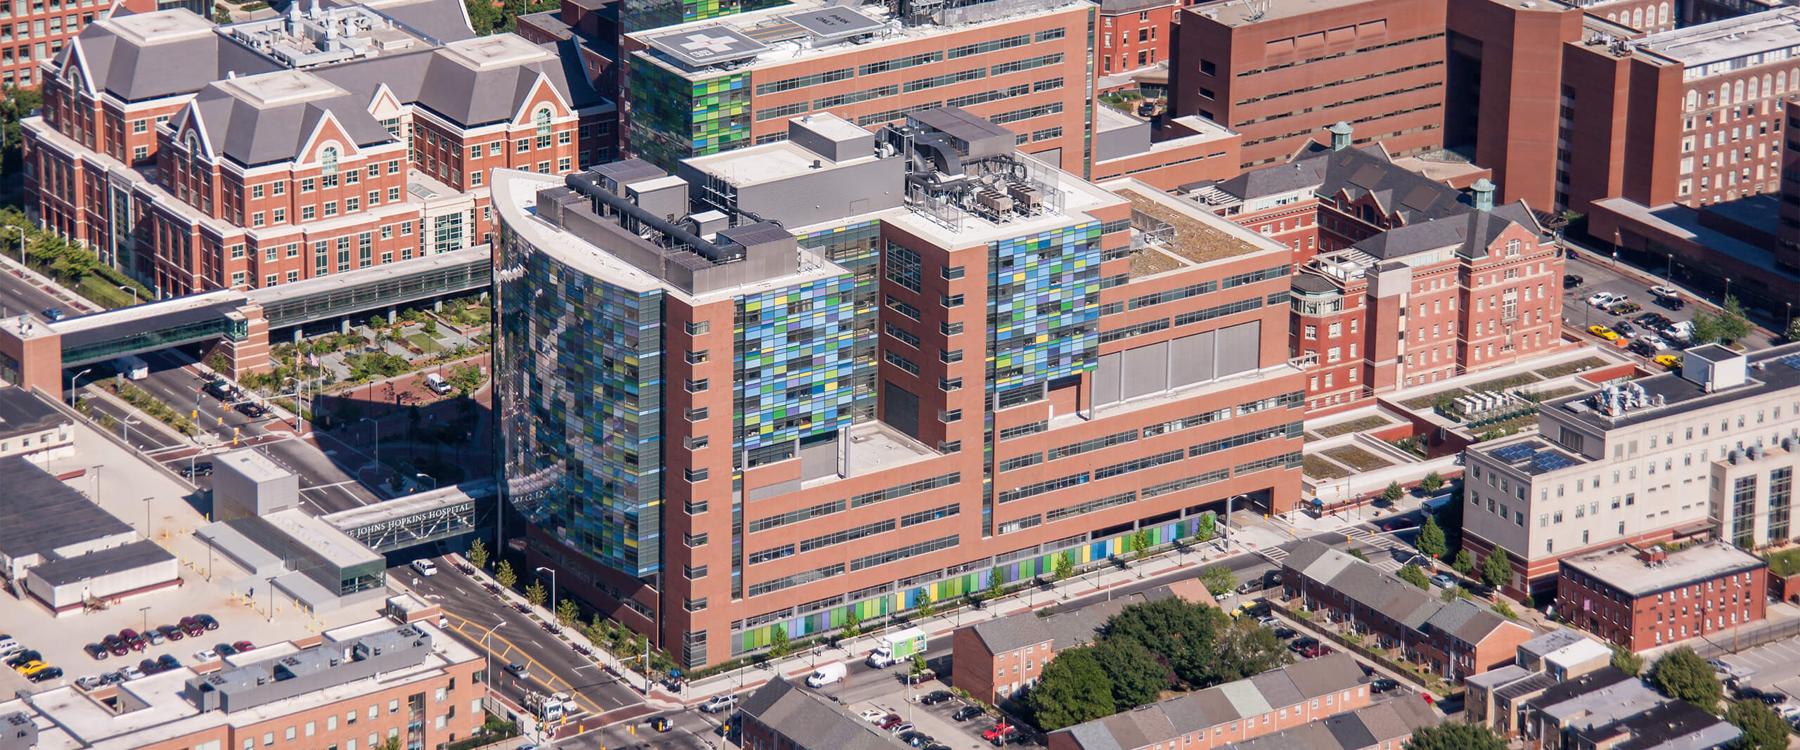


Optimizing Patient Discharge Process to Minimize Delays
Host: Dr. Renee Blanding
Team: Mohit Gupta, Sharvi Dadhich, Chuyang Yu, Siddhay Kapat

Slide 2
Acknowledgement
Dr. Renee Blanding, Vice President, Medical Affairs, Johns Hopkins Bayview Medical Center
2) Dr. Pamela Sheff, Director, Center for Leadership Education, JHU
3) Riyaa Jadhav, Teaching Assistant, Center for Leadership Education, JHU
4) Yuchen Cui, Teaching Assistant, Center for Leadership Education, JHU The team is grateful for your guidance and support throughout the project. The project has been a great learning experience for the team.
Literature Review

Slide 3
Scope & Methodology
Problem at hand
The scope of this project involves a comprehensive analysis and optimization of the patient discharge workflow to reduce delays. This includes collecting and analyzing data on current discharge times, conducting time studies to map out each step in the discharge process, and identifying specific barriers and inefficiencies. The project was focused on getting feedback from key stakeholders and proposing cost-effective improvements to streamline the discharge procedure, aiming to increase efficiency and meet the hospital’s discharge targets.
Location: Johns Hopkins Bayview Medical Center
Hospital Capacity: 320+ Beds
Area in focus: Patient discharge process
Project Duration: 6 weeks
Hospital Floors Observed: Emergency Department, Burton Pavilion, Med A & Med B
Doctors Interviewed: 5
Nurses Interviewed: 12
Pharmacy Specialist Interviewed: 1
Med-reconciliaiton Technician Interviewed: 1
Hospital Administrator Interviewed: 1
Our Methodology
Literature Review
Analyse hospital capacity meetings and research papers
Stakeholder Interview
Observe and interview different hospital departments
Time Study Analysis
Record time for each link in the discharge process
Literature Review

Slide 4
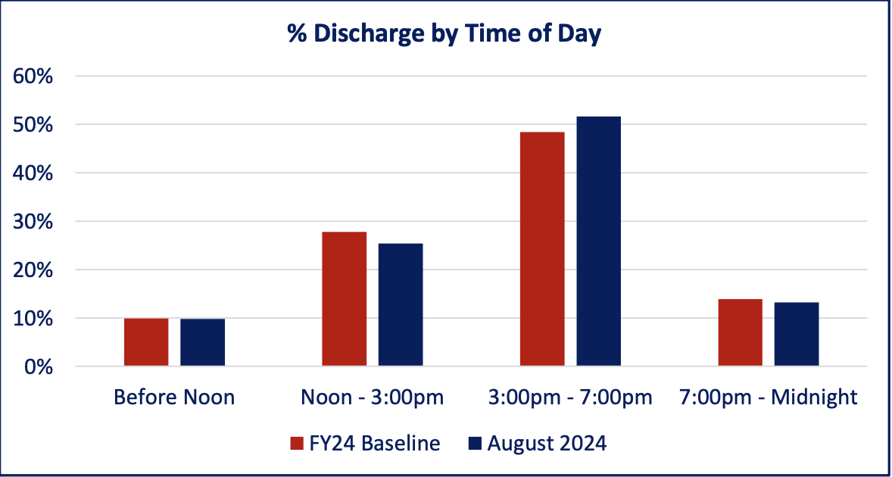
Problem Statement
92% of patients are discharged after the hospital’s target time of noon (12pm)

Slide 5

Factors
Doctors
Transportation
Diagnostics
Nurses
Patients
Pharmacy
92%
of patients are discharged after the hospital’s target time of noon (12pm)

Slide 6
Current Status
Min Discharge Time | 3Hrs 50 Mins
Max Discharge Time | 15Hrs 35 Mins
Doctors
Rounds
Pre-Rounds
Diagnostics
Discharge navigator
Nurses
Pharmacy
Ready for discharge
Transport from Hosptial
60 min | 10-20 min | 30-120 min | 60- 90 min | 30-120 min | 60-180 min | 10-165 min | 30-240 min
Day Before Discharge
Day of Discharge

Slide 7
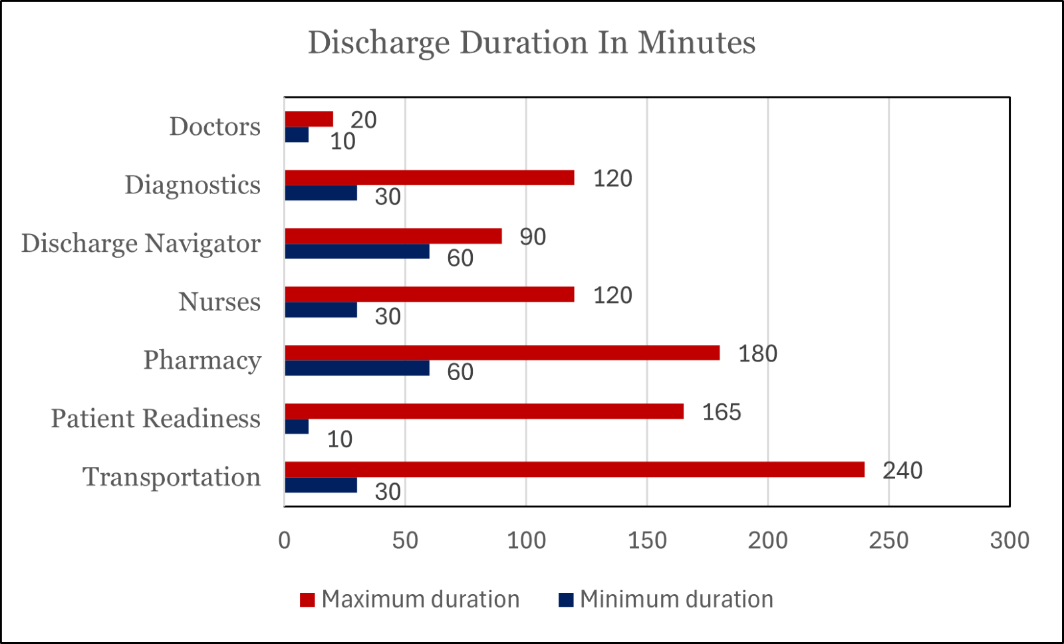
Impact Overall
Saves up to 29% time
Time that can be saved by implementing our recommendations:
Discharge List - 96 mins​
Notification on EPIC - 90 mins
Pre-order drugs - 90 mins
AI Model - 60 mins
Current Discharge Duration

Slide 8
Our Recommendations
3 Step Solution
Why PSC?
Discharge List
Pre-order Drugs
Notification on Epic
Pre-Rounds
Diagnostics
Discharge Navigator
Nurses
Pharmacy
Ready for discharge
Transport from Hosptial
Using AI
AI Med Rec
AI prediction

Slide 9
3-Step Solution
After daily Multi-D meetings, develop a discharge list to streamline morning doctor visits. This process could accelerate issuing discharge notes, potentially saving 1 hour and 36 minutes per patient discharge.
Why PSC?
Discharge List
Pre-order Drugs
Notification on Epic
Pre-Rounds
Diagnostics
Discharge Navigator
Nurses
Pharmacy
Ready for discharge
Transport from Hosptial

Slide 10
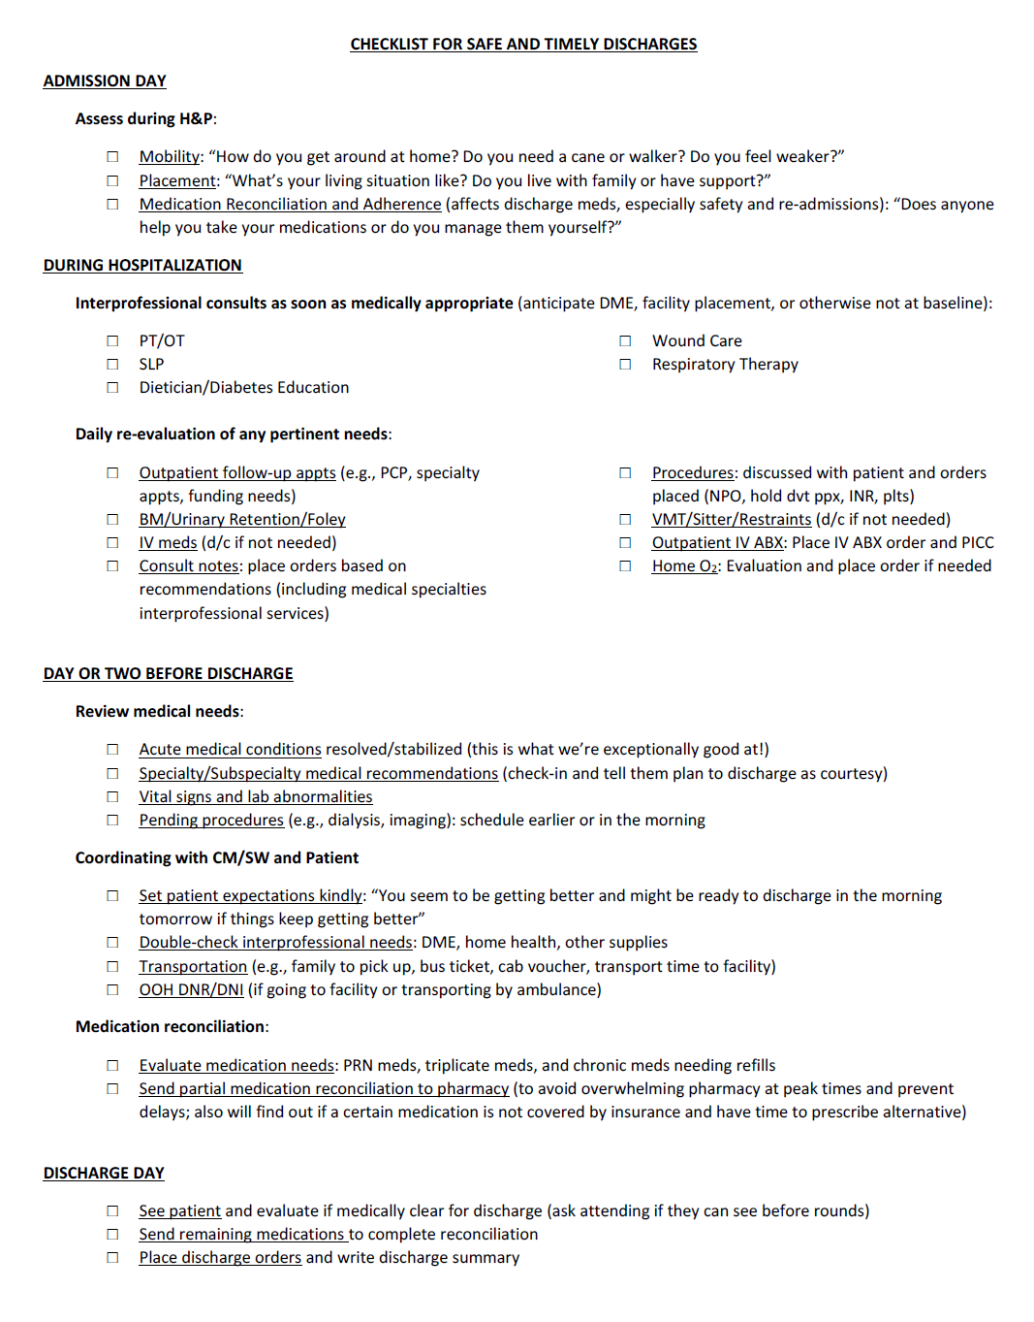
Discharge List
Day of admission
For case manager

Slide 11
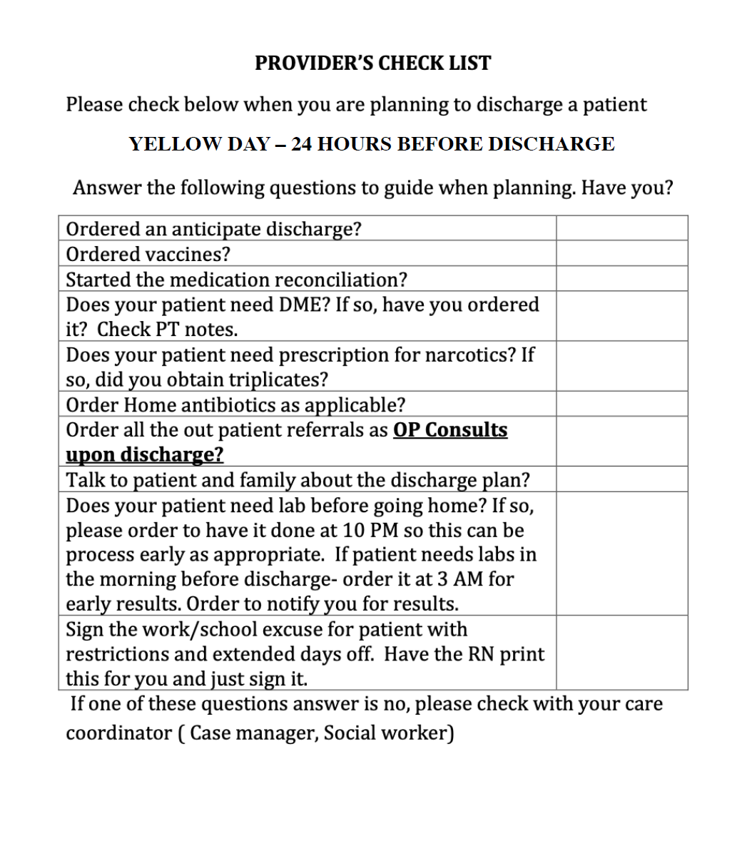
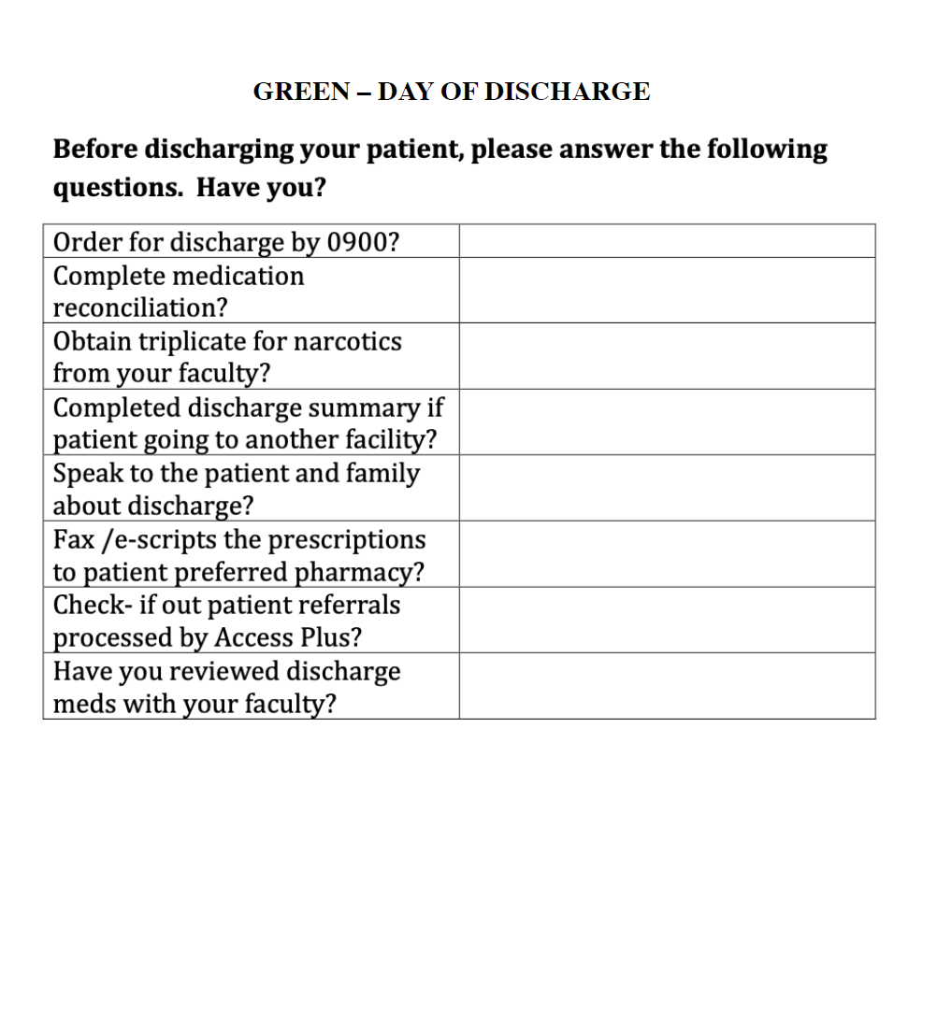
Discharge List
For Doctor
The day before discharge
The day of discharge

Slide 12
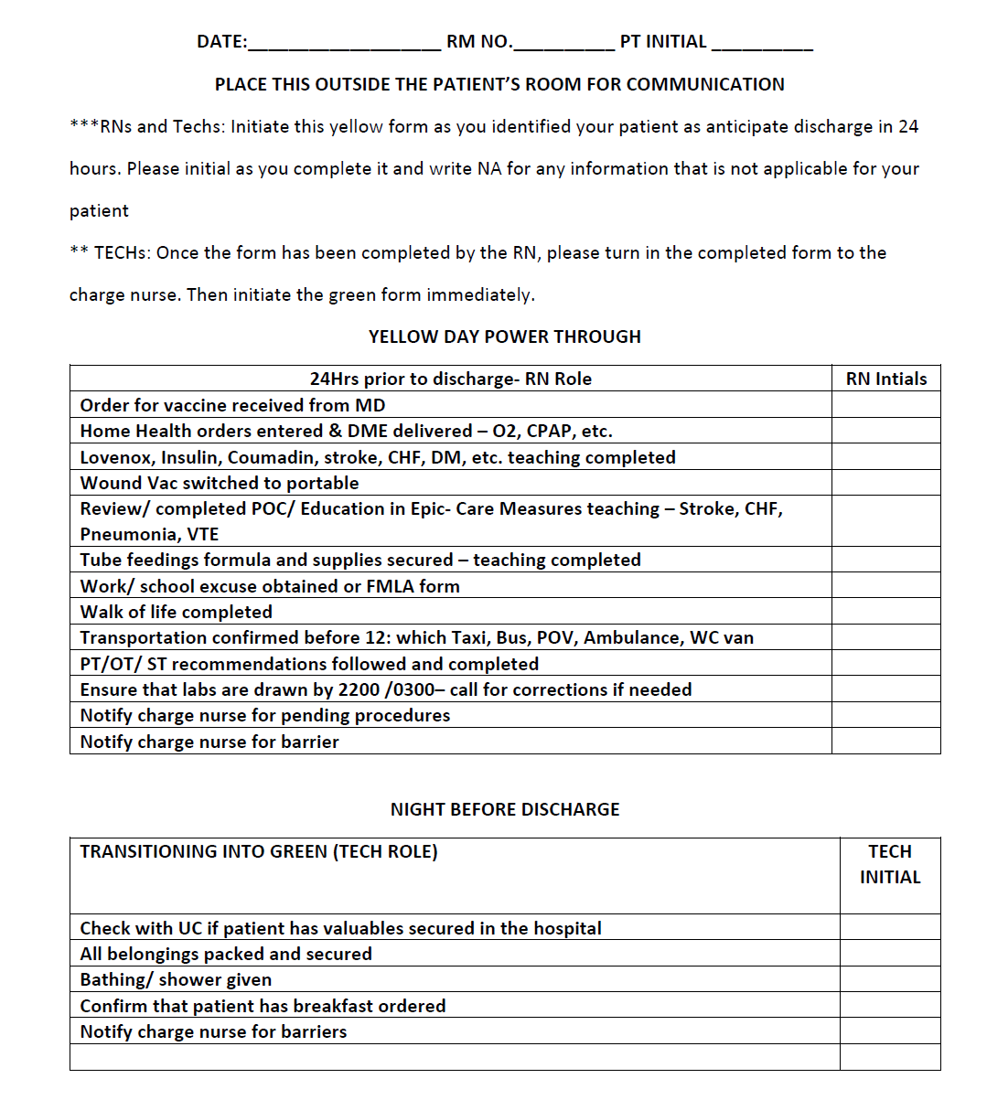
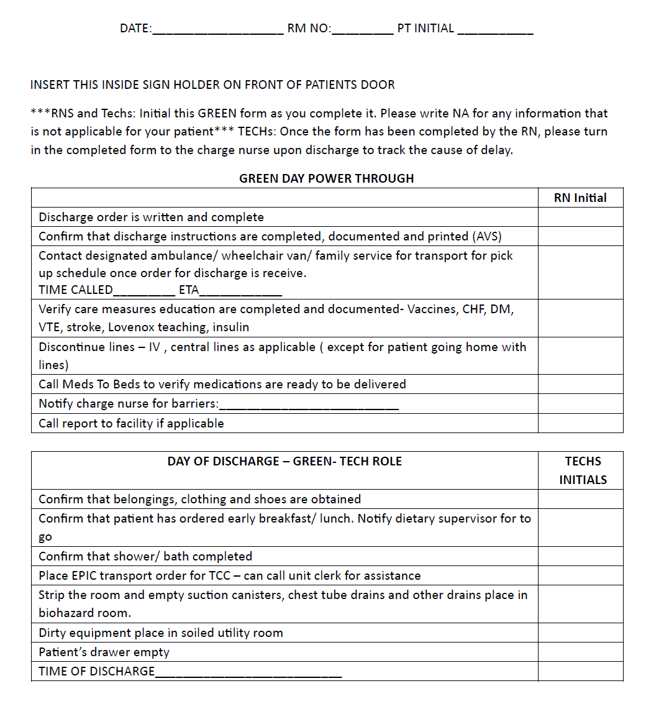
Discharge List
For Nurses
The day before discharge
The day of discharge

Slide 13
3-Step Solution
Submit prescription orders to the outpatient pharmacy a day before discharge to ensure medications are ready for pickup. Any changes on discharge day can be adjusted, saving an estimated of 1 hour and 30 minutes.
Why PSC?
Pre-Order Drugs
Discharge List
Notification on Epic
Pre-Rounds
Diagnostics
Discharge Navigator
Nurses
Pharmacy
Ready for discharge
Transport from Hosptial

Slide 14
3-Step Solution
Enable nurse-oriented notifications in EPIC. When a doctor places an order, real-time alerts will notify nurses, ensuring they are aware of patients ready for discharge. It is estimated that this step could save approximately 1 hour and 30 minutes.
Why PSC?
Notification on Epic
Discharge List
Pre-order Drugs
Pre-Rounds
Diagnostics
Discharge Navigator
Nurses
Pharmacy
Ready for discharge
Transport from Hosptial

Slide 15
Using AI
We propose integrating predictive analytics and AI-driven clinical decision support systems (CDSS) with Epic EHR to streamline medication reconciliation at discharge. This solution prioritizes high-risk medications and provides real-time alerts, reducing reconciliation time from 75 minutes to approximately 15-30 minutes, enhancing efficiency and patient safety.
Why PSC?
AI Med Rec
Pre-Rounds
Diagnostics
Discharge Navigator
Nurses
Pharmacy
Ready for discharge
Transport from Hosptial
AI Transport

Slide 16
Using AI
Transportation from the hospital to homes or secondary facilities often presents challenges. Leveraging existing AI models that predict treatment needs, we can also estimate the patient's length of stay. This prediction can notify families of the pickup date and schedule ambulance services, ensuring a smooth discharge process and minimal delays
Why PSC?
AI Transport
Pre-Rounds
Diagnostics
Discharge Navigator
Nurses
Pharmacy
Ready for discharge
Transport from Hosptial
AI Med Rec

Slide 17
Incentive Program
Incentive Options
Recognition and Rewards
Goody Bags for High-Performers
Meal Vouchers: Offer meal vouchers to nurses placing discharge orders before 10 am to encourage early action.
Public Recognition
Star Awards
Weekly Emails: Send weekly feedback emails to APPs and physicians, highlighting and
acknowledging top
Leadership Acknowledgement
Public Recognition by Leadership: Physician leadership should publicly recognize top performers through responses to weekly emails, reinforcing their value
Balanced Approach
Intrinsic Motivation Emphasize the impact of timely discharges on patient care and hospital efficiency in communications
Continuous Improvement
Discharge Target- More Than 20% Discharges before noon for each department

Slide 18
Implementation Roadmap
Incentive Program
Implementation Timeline: 6 weeks
01
Discharge List
Implementation Timeline: 3-6 months
03
Pre-order Drugs
Recommendations
Implementation Timeline: 3-6 months
02
04
Notification on Epic
06
Implementation Timeline: 1-3 months
05
AI Med Rec
AI Transport
Implementation Timeline: 6-12 months

Slide 19
Limitations
Staff, including nurses and doctors, may resist new features due to familiarity with existing processes and concerns about increased workload. Ensuring proper training and understanding of new protocols is essential for successful adoption.
Incomplete or inaccurate historical data used to train the AI model can lead to flawed predictions about patient discharge times. Missing patient histories or poorly recorded outcomes can result in unreliable forecasts.

Slide 20
Conclusion
Dominant factors
Unscheduled doctor visits, nurses not checking orders on EPIC promptly, overloaded pharmacy staff, and transportation delays
Our recommendations
Quick implementation: 3-step solution – discharge list, preorder drugs, notification on EPIC
Developing AI model - assist in med reconciliation and transportation
Incentive program - recognize top-performing individuals and departments
Impact
Reduce average discharge time by 29% saving up to 4 hours

Slide 21
Thank You

